Slide 1

EMPLOYEE ATTRITION PREDICTION
- Leveraging Data Insights to Predict Employee Turnover
NIHA RAHIM
Data Analytics
20/12/2025

Slide 2
OBJECTIVE
To analyze employee data and build a classification model to predict whether an employee will leave the organization.
This helps the HR teams reduce attrition, improve employee retention strategies, and enhance workforce planning.

Slide 3
OVERVIEW STEPS
Dataset loading
– Data preprocessing
– Training the dataset
– Creating multiple machine learning models
– Selecting the best-performing model

Slide 4
CHOOSING A DATASET
Dataset was provided containing employee details such as education, age, city, gender, experience etc.
Target column: LeaveOrNot
Columns represent data about employee background and workplace conditions.
The dataset helps identify patterns that influence attrition.

Slide 5
FEATURES
Education
– Joining Year
– City
– PaymentTier
– Age
– Gender
– EverBenched
– ExperienceInCurrentDomain
– EmployeeID

Slide 6
TARGET
LeaveOrNot
0 =Employee stays
1 =Employee leaves

Slide 7
UNDERSTANDING THE PROBLEM
Problem Definition
– Companies face employee turnover which affects productivity, recruitment cost, and project efficiency.
– A prediction system can help HR intervene early and retain high-performing employees.

Slide 8
DATA PREPROCESSING
Handled null values
Label Encoding for categorical values
Scaling numerical columns
Outliers removal using capping

Slide 9
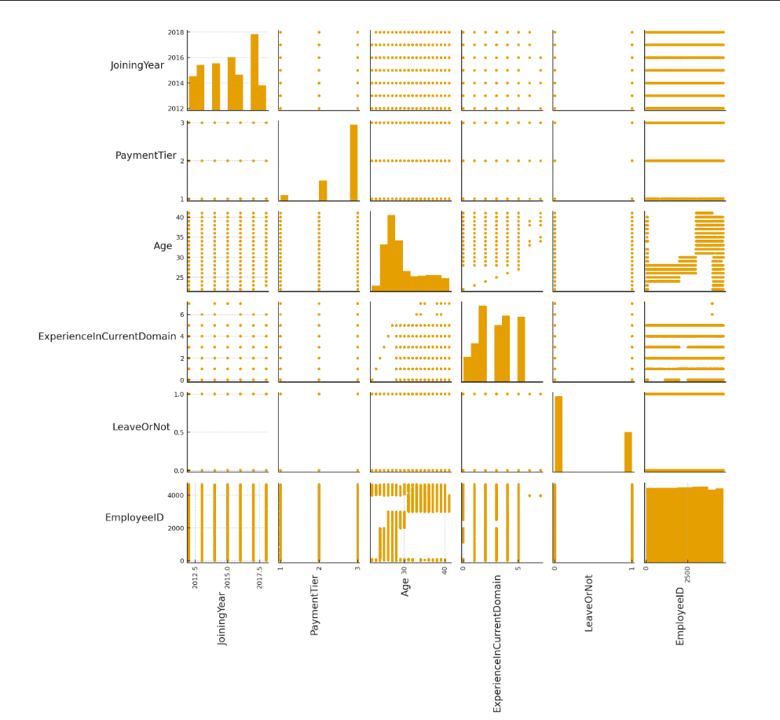
EXPLORATORY DATA ANALYSIS (EDA)
Performed visualizations such as histograms, boxplots, and scatterplots to understand data distribution.
Identified patterns in attrition against factors like age, experience, and payment tier.

Slide 10
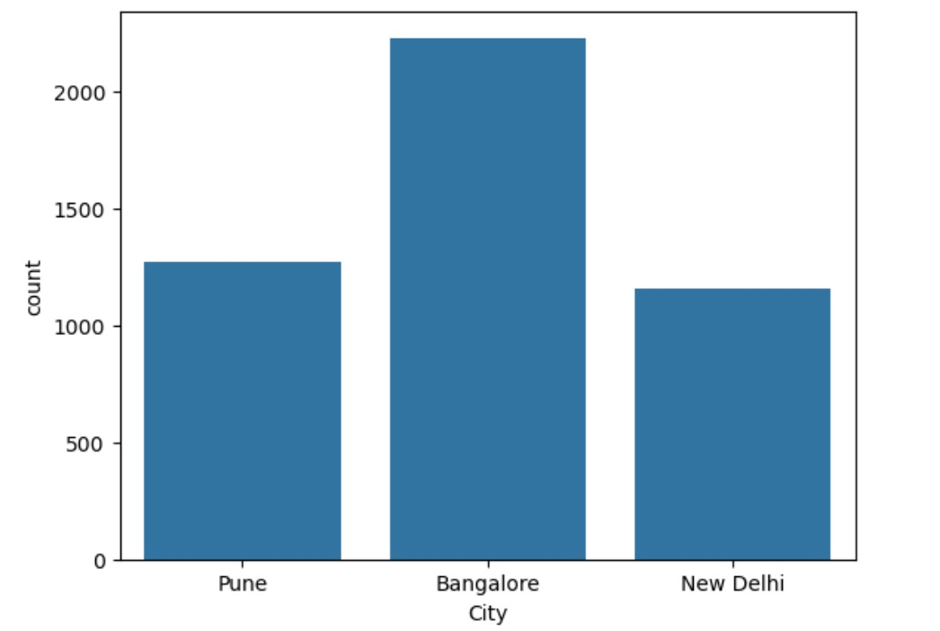

Slide 11
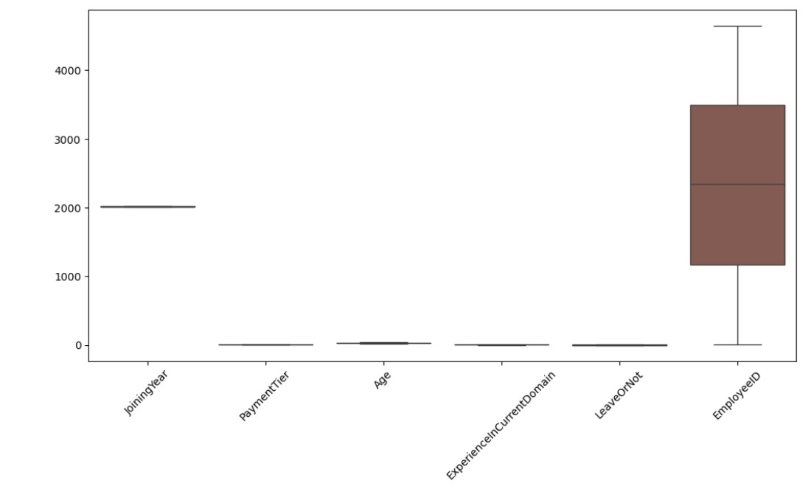
BOX PLOT

Slide 12
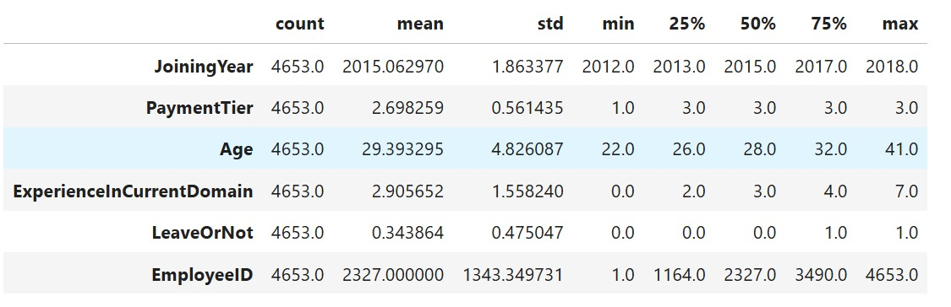
SUMMARY STATISTICS

Slide 13
DATA ANALYSIS TECHNIQUES
Techniques Used :
Descriptive statistics
Data visualization
Correlation analysis
Classification modelling

Slide 14
MODEL EVALUATION
Model Used :
Logistic Regression
SVM
Random Forest
Decision Tree
AdaBoost
Gradient Boosting
XGBoost
KNN

Slide 15
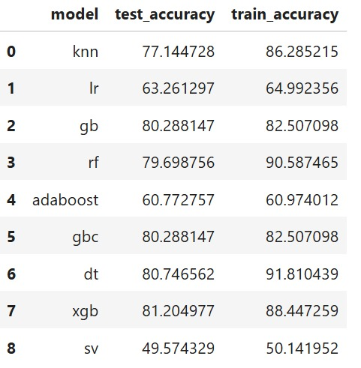
MODEL PERFORMANCE

Slide 16
MODEL EVALUATION
Validation Methods :
Cross Validation
Cross-validation is a technique used to evaluate how well a machine learning model will generalize to unseen data.The dataset is divided into k subsets (folds). The model is trained on k–1 folds and tested on the remaining fold. This process is repeated for all combinations, and the average score is taken as the final evaluation.
This prevents overfitting and ensures a more stable and reliable performance estimate.

Slide 17
SOLUTION IMPLEMENTATION
Implementation steps
Deploy Model : Integrate the Employee Attrition Prediction model into the organization’s HR
management system.
Set Up Monitoring : Monitoring ensures the model remains reliable over time.
Conduct Field Testing : Run a pilot testing phase with a selected department or employee
group,this helps ensure reliable decision-making before organization-wide rollout.
Document and Train : Prepare complete documentation covering and train HR teams to correctly
analyze predictions and make data-driven decisions for employee retention.

Slide 18
CONCLUSION
The analysis of the employee dataset helped us understand how different factors such
as age, experience, salary, and department influence overall employee performance. By
exploring the data and building machine learning models, we were able to identify clear
patterns, such as the positive impact of experience on salary and the role of department
in determining employee outcomes. The models provided useful predictions that can
support decision-making in areas like hiring, promotion, and salary planning. Overall,
this project gives a clear and meaningful understanding of the workforce and can help
improve employee management in a simple and practical way.

Slide 19
Thank you

